Slide 1
CDISC Initiatives and Collaborations
Sam Hume, DSc
VP, Data Science
CDISC

Slide 2
CDISC Big Picture
Standards
Design & Develop
Data Science
Automation
Software Tools
Technical Standards
Publish & Adopt
Openness
Implement
Automate
IT Infrastructure

Slide 3

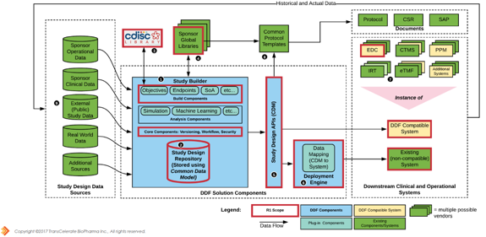

CDISC Library Provides the Foundation
Software Applications Consume Standards Metadata via the API
Standards
Metadata
Controlled Terminology
API
Pipeline
Executable Conformance Rules
Biomedical Concepts
Codelist Subsets
Dataset Specializations
Implementation Guide Text
Standards Mappings
Analysis Results
Standard
TAUG Metadata
Derivations and Mappings
Machine-readable Examples
Draft Standards Metadata
Tables, Listings, and Figures
QRS Metadata
Trial Master File Reference Model
CRF Collection
Diff Content Between Versions

Slide 4

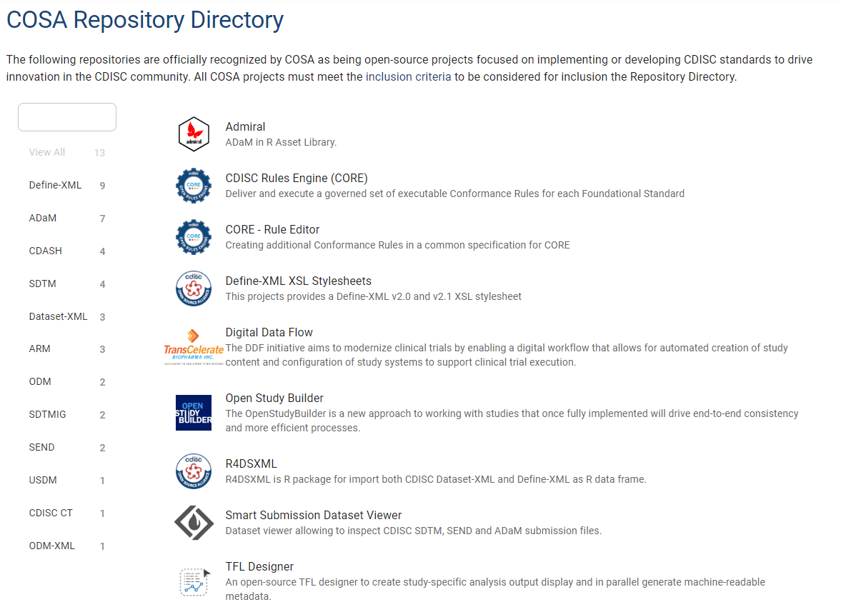
CDISC Open-Source Alliance (COSA)
Directory has ~ 16 projects
Completed quarterly webinars
Completed 3 workshops
Completed first hackathon
~ 20 solutions created
More hackathons scheduled
Conference presentations
Collaborations with PHUSE and Pharmaverse
Open-source is trending…
https://cosa.cdisc.org/

Slide 5

COSA Dataset-JSON Hackathon
Language | # Solutions
R | 5
SAS | 4
Python | 5
JavaScript | 4
Java | 1
Swift | 1
XSLT | 1
https://cosa.cdisc.org/
Dataset-JSON is an ODM v2.0 draft standard for exchanging tabular datasets
It is based on the Dataset-XML v1.0 specification with enhancements, including
Much smaller file sizes
The addition of essential metadata to support data browsing and simple conversions
Designed to meet the requirements of the regulatory submission use case

Slide 6
ODM v2.0 Moving into Public Review
Completed Internal Review, starting Public Review November 8th
Planned final release early Q2 with supplements to follow
May be used in the DDF project
Study Setup
Study Design Model
Integration
Enhanced semantics
Data Exchange
REST API*
Flexible metadata beyond CRFs
RWD / HL7 FHIR support
End-to-end Standards
Enhanced MethodDef
Traceability enhancements
JSON support
Matrix forms
Data Queries
Dataset-JSON
Biomedical Concepts

Slide 7

CORE Program Roadmap
Production Release 2: Enhanced Engine and Rules
Engine: Open-Source under COSA; evolved; maintained by CDISC
Conformance Rules: New CDISC Standards released with Conformance Rules
Functionality: Advanced functionality
Deployments: Vendor- or user-provided cloud & local production environments
Q3 2023 – Q2 2024
Production Release 1: Submission-ready Engine and Rules
Engine: Open-Source under COSA; evolved; maintained by CDISC
Conformance Rules: Remainder of CDISC Foundational Standards
Functionality: Complete conformance checking functionality
Deployments: Vendor- or user-provided cloud & local production environments
Q3 2022 – Q2 2023
Establish CORE Roadmap Board
Evaluation Release
Engine: Open-Source, developed by CDISC, published under COSA
Conformance Rules: SDTM 2.0 and SDTMIG 3.4
Functionality: Basic conformance checking functionality
Deployments:
CDISC cloud evaluation
Azure Marketplace evaluation
Desktop evaluation – not achieved yet
Q3 2021- Q2 2022
CDISC
Vendor/User

Slide 8
What is COSMoS?
Pragmatic Implementation of Biomedical Concepts
3 Key pieces
Extend foundational standards
Add explicit relationships between variables
Additional operational metadata, e.g., data type, etc.
Biomedical Concepts (BC)
Provides semantics - aligned with NCI terminology
Supports study design, Schedule of Activities (SOA)
Dataset Specializations
Standard datasets pre-configured to represent a Biomedical Concept
Tailored to BCs to link with unambiguous semantics & definitions
Supports programmers
Can be used to create Define-XML or CRFs
Can be used to create Value Level Metadata in a Define-XML
COSMoS = Conceptual and Operational Standards Metadata Services

Slide 9
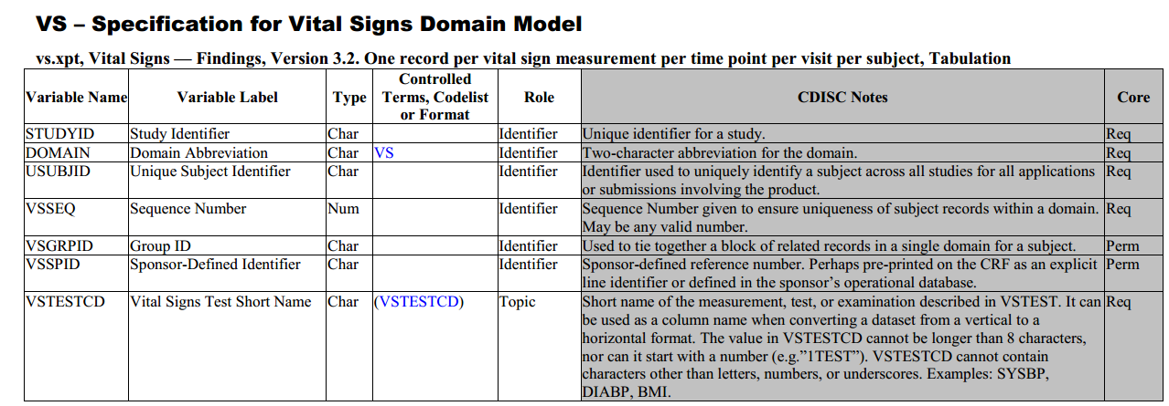

Biomedical Concepts and Dataset Specializations
Base VS Dataset Definition
Add explicit relationships between variables
Add operational metadata such as data type, length, significant digits, value
Add relationships to concept-based dataset definition specializations
VS.HEIGHT specialization
VS.SYSBP specialization
VS.HR specialization
For each dataset specialization update the variable definitions to match what is needed to represent the concept. A concept code and name is added to each dataset definition. A Where Clause for the specialization may be added.
Concept codes/name added to dataset metadata and used to provide the semantics for each specialization
Concept-specific codelist subsets created for use in the specializations. Maintained as part of the CT dictionary. A column value or default will be specified.
Biomedical Concept System

Slide 10













TransCelerate Digital Data Flow Enabling Downstream Automation and Analytic Insights
IRT
Document Flow
EDC
Today
EHR
CTMS
Protocol Document
DCT
Study Team Design & Protocol Authoring
EDC
Study Definitions Repository (SDR)
CTMS
Tomorrow
IRT
Digital Flow
EHR
Unified Study Definitions Model (USDM)
API Specs
Controlled Terminology
Study Builder, Protocol and/or Content Authoring Tools
DCT

Slide 11
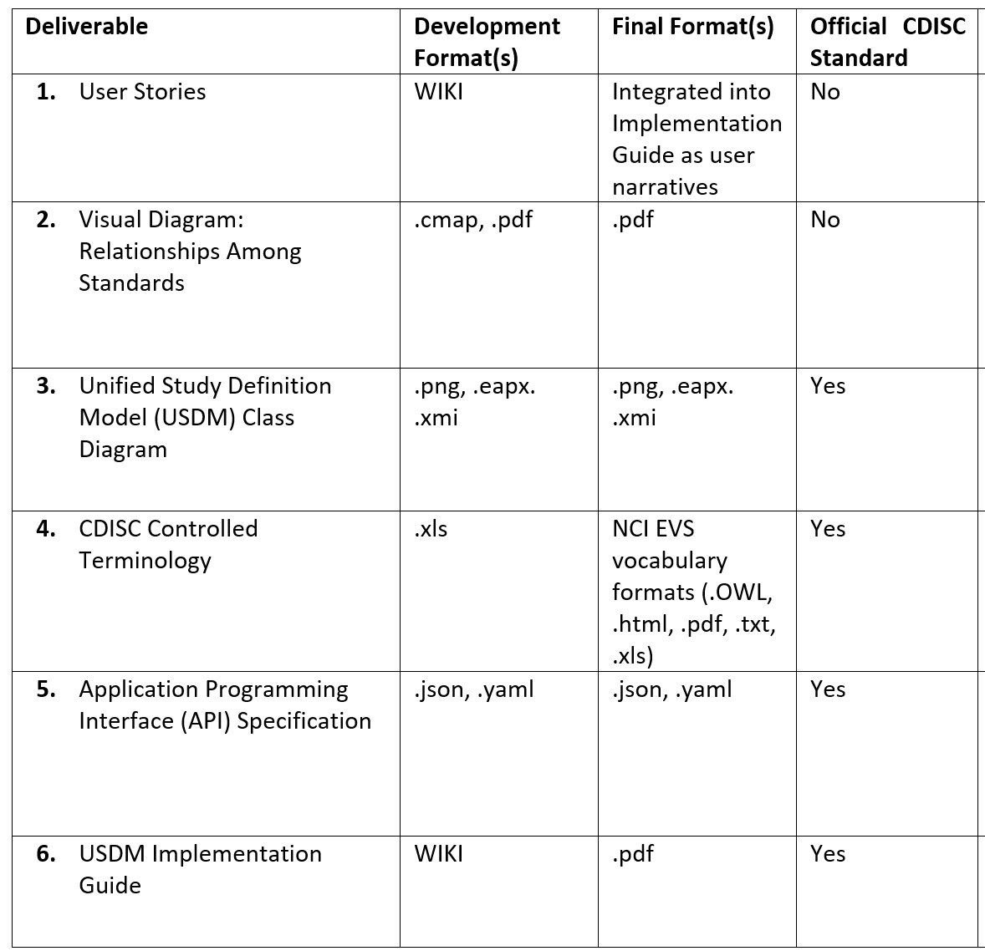
Digital Data Flow Phase 2 Overview
Enhancements/bug fixes from DDF Phase 1
Use of Biomedical Concepts to facilitate EDC Automation
Generate the TransCelerate Common Protocol Template
Handle complex study designs
Updates from Connectathon feedback

Slide 12
CDISC Real World Data Resources
CDISC BASIC
SDTM OMOP Mapping
SDTM for Observational Studies
REDCap & OpenClinica CDASH eCRFs
FHIR to CDISC Mapping
RWD
Example Collaborations:
Vulcan FHIR Accelerator
Droice Labs
IMI Dragon

Slide 13
CDISC BASIC: Lowering Barriers to Using CDISC
Reduce volume by concentrating on most common data
Present collection and tabulation in an integrated manner
Write for an audience new to CDISC and less immersed in data handling
Link to other resources
REDCap and OpenClinica CRFs
CDISC resources such as
eCRF Portal
Knowledge Base
Free educational courses and webinars
Specific CDISC Standards for more detail, when needed

Slide 14
Analysis Results Standards
Formal model that describes analysis results metadata
Analysis Results Metadata Technical Specification (ARM-TS), to support automation, traceability, and creation of data displays
Define an Analysis Results Data (ARD) structure, to support reuse and reproducibility of results data
Illustrate and exercise ARD and ARM-TS with a set of machine-readable common safety displays

Slide 15
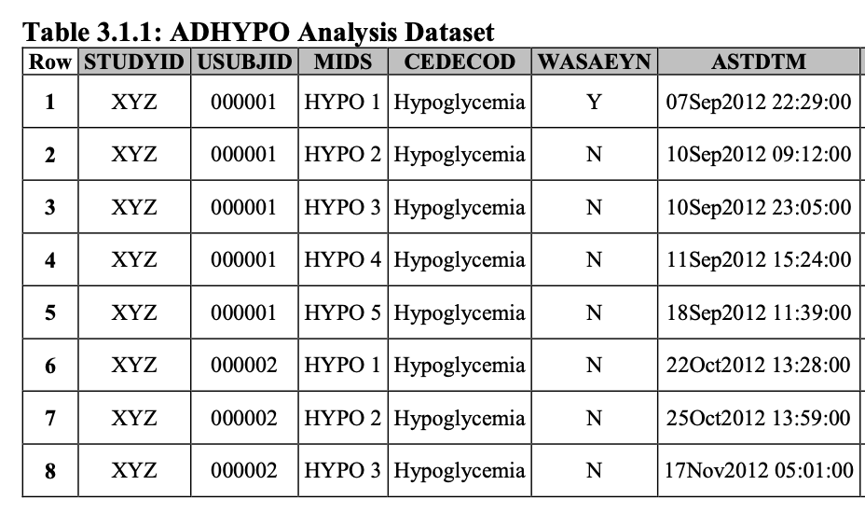
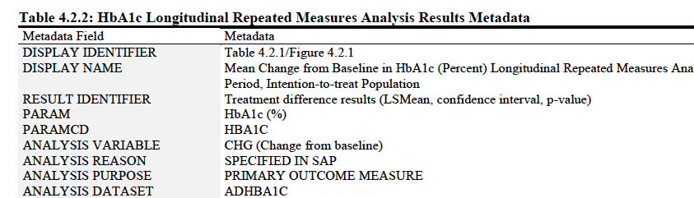
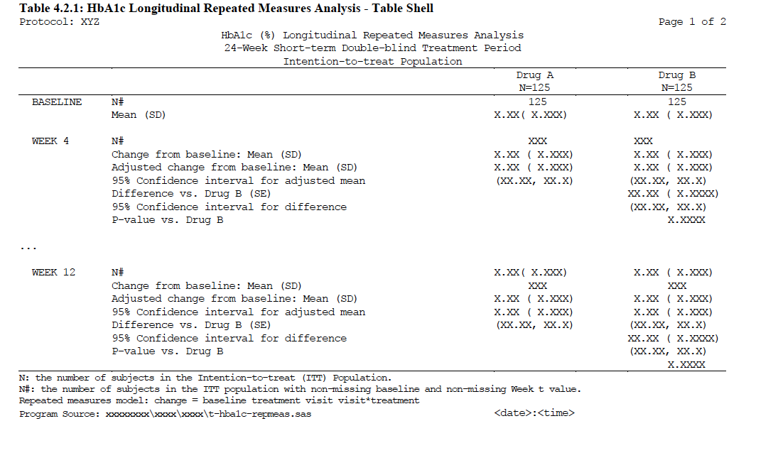
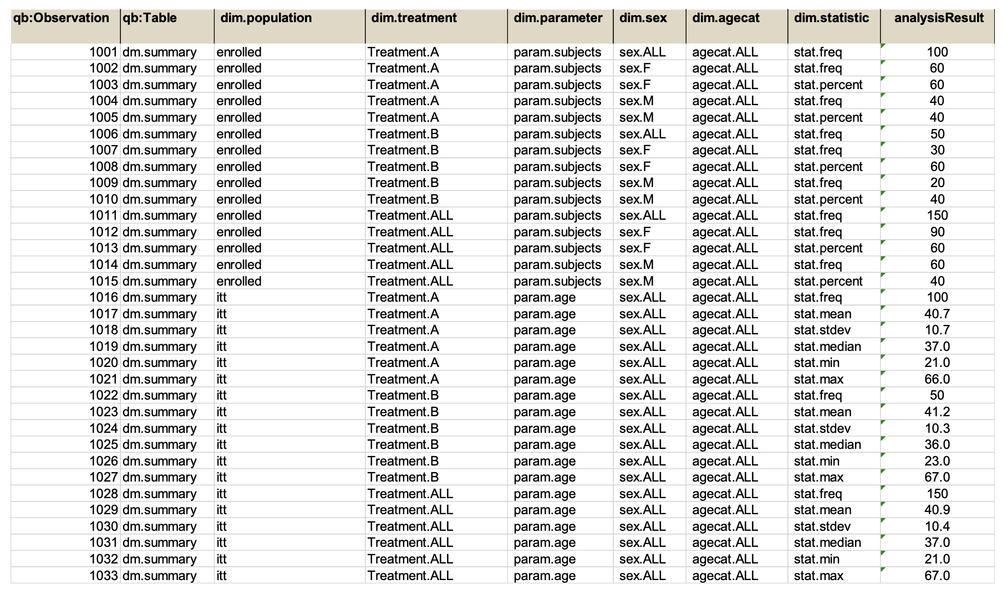
Analysis Results Standard: Shifting the Paradigm
ARM v1
ARM Extension Technical Specification
ADaM Dataset
Automation
Reuse
Traceability
Analysis Results Dataset
Display

Slide 16
Thank You!

Slide 17
Additional CDISC Initiatives and Collaborations

Slide 18
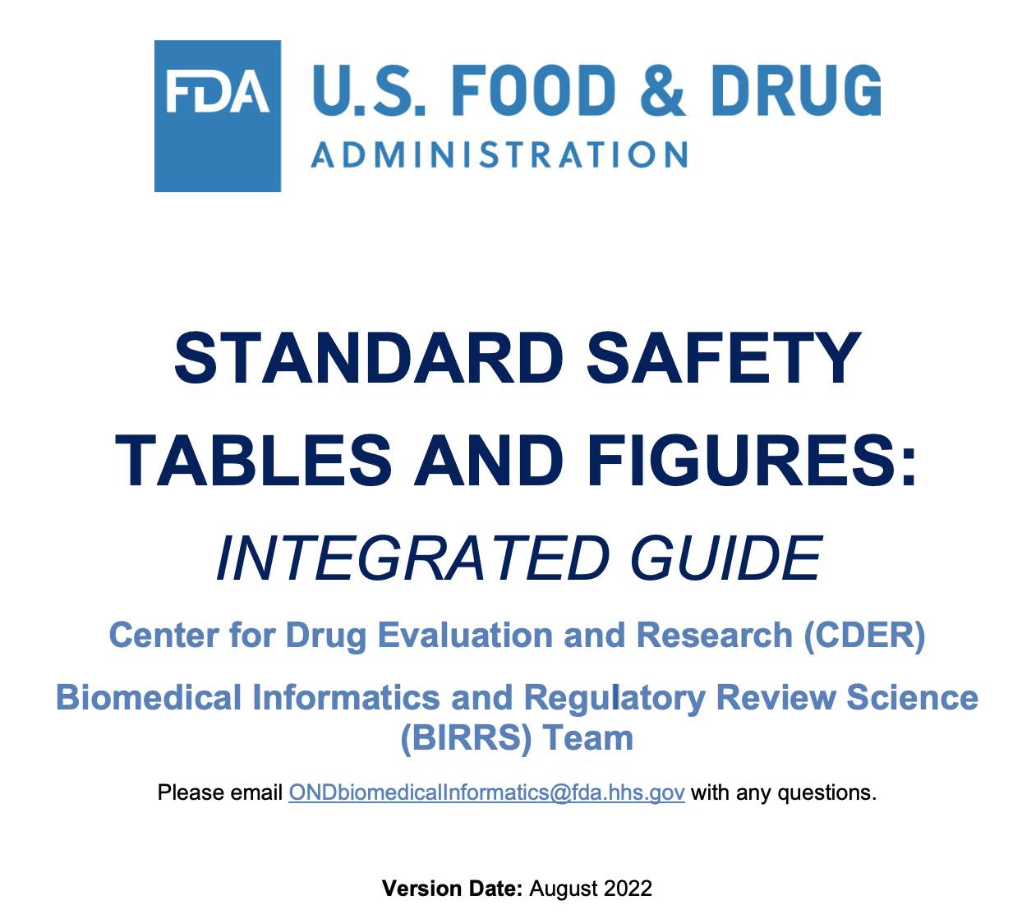
Support for FDA Standard Safety Tables and Figures
Formal model that describes analysis results metadata
For a selection of FDA tables and figures, create packages containing
Machine readable displays
Associated analysis results metadata
Analysis results dataset examples
Underlying ADaM datasets
Make packages freely available

Slide 19
Analysis Results Desired Future State
Formal model for describing analyses and results as data
Facilitate automated generation of results
From static to machine readable results
Improved navigation and reusability of analyses and results
Support storage, access, processing and reproducibility of results
Traceability to Protocol/SAP and to input ADaM data
Open-source tools to design, specify, build and generate analysis results

Slide 20
CORE Rule Count by Standard/Version
Foundational Standard | Rule Count
SDTMIG v3.4 | 336 fully executable 445 total rules
SDTMIG v3.2 | 416 total rules
SDTMIG v3.3 | 450 total rules
SENDIG v3.1 | 303 total rules
ADaMIG v1.3 | 595 total rules
Other Rules
Regulatory Rules FDA | SDTMIG (3.3/3.2) 186 SENDIG (3.0/3.1) 175
Regulatory Rules PMDA | To be analyzed
Define-XML Cross-Check | Definitions are being generated (±172)

Slide 21


CDISC eCRF PORTAL
The eCRF Portal provides machine readable eCRFs
Visual representation of CRF layout with CDASH annotations
Machine-readable ODM format
Includes CRFs from:
CDASH Implementation Guide v2.1
Crohn’s Disease Therapeutic Area User Guide
Upcoming – COVID-19 Therapeutic Area User Guide
54 eCRFs to date (Oct 2022)
Formedix offers the Ryze platform at no cost
Used as a base to create OpenClinica and REDCap CRFs
eCRF Portal

Slide 22


: An IMI-Funded Project
Develop AI-enhanced tools for evaluating COVID patients’ CT scans and clinical data to provide accurate diagnoses and predict patient outcome.
Develop AI-enhanced tools for evaluating COVID patients’ CT scans and clinical data to provide accurate diagnoses and predict patient outcome.
Develop AI-enhanced tools for evaluating COVID patients’ CT scans and clinical data to provide accurate diagnoses and predict patient outcome.
‘s Role
EHR data harmonization design and mapping support to feed data to AI
COVID-19 User Guide v2.0 Imaging Guide
Considerations for using CDISC standards for observational research
CDISC Basic: abridged CDASH & SDTM for non-submission research

